Slide 1
CodeToConnect Bofa
Team F3:
Ong Yuan Sheng
Kenneth Tan
Tan Zi Qi

Slide 2
Overview
Programming Language: Python
Components Attempted: Market Data Producer, Trade Event data Producer, Pricing Engine, Report Generator, Dashboard

Slide 3



Design and Architecture
Load Json Data
Extract and transform Data
Front End Dashboard with react

Slide 4
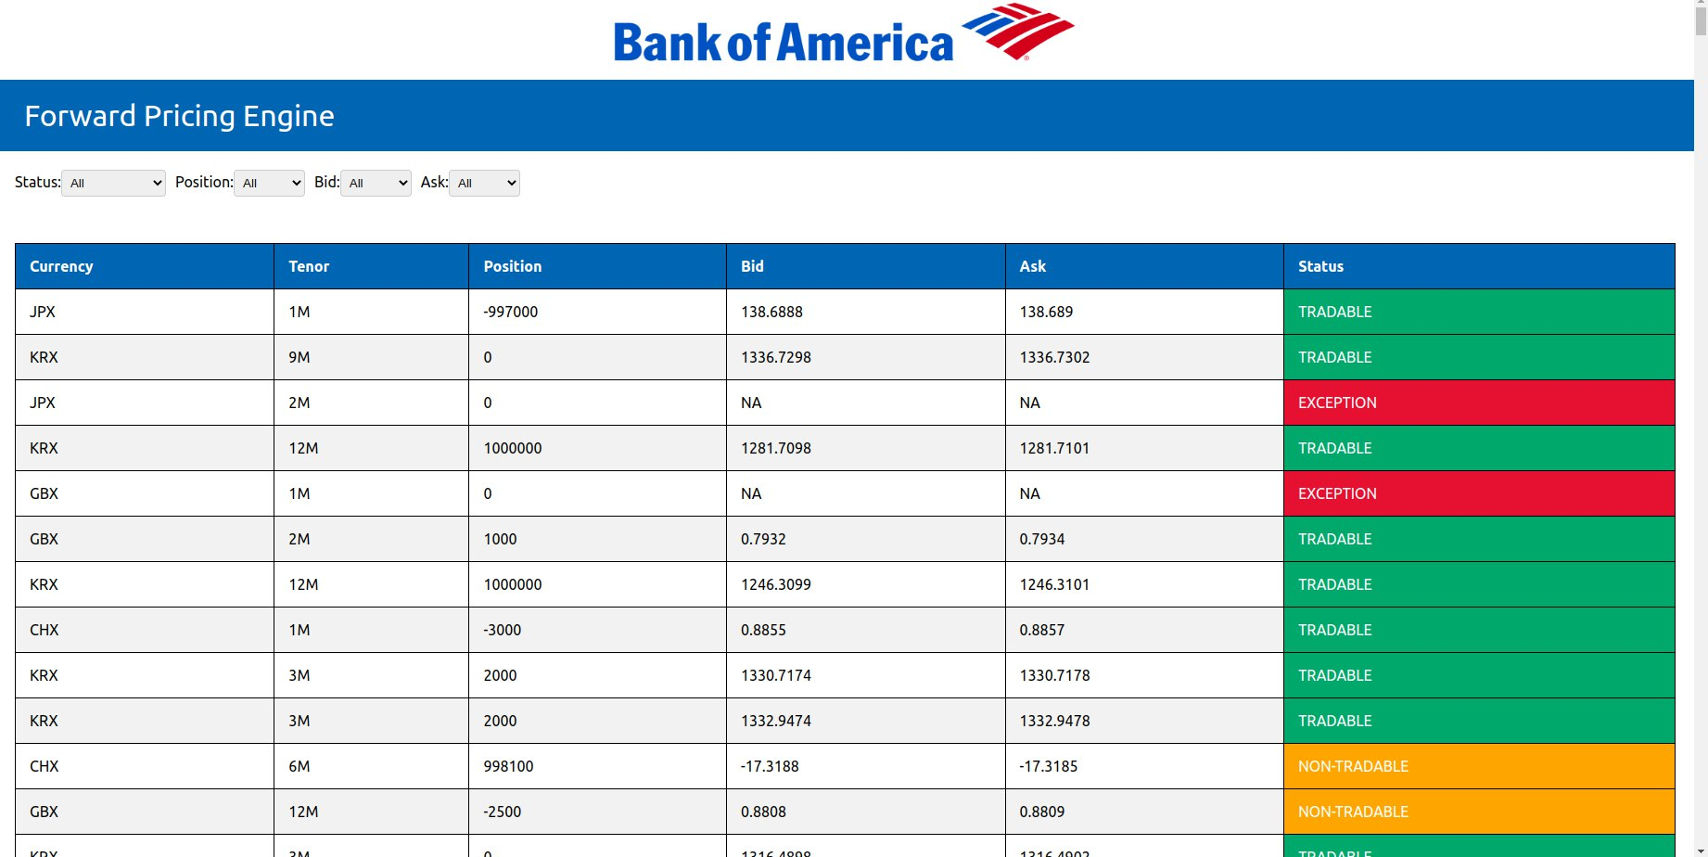
UI Design
User is able to filter and query Bid, Ask, Position, and QuoteStatus

Slide 5
Takeaways and Conclusion
There were many factors to consider that can affect the Quote Status
There were many edge cases to consider as well
Hence it is important to draw out flowcharts and architecture before starting on the code

